Slide 1

Software

Slide 2
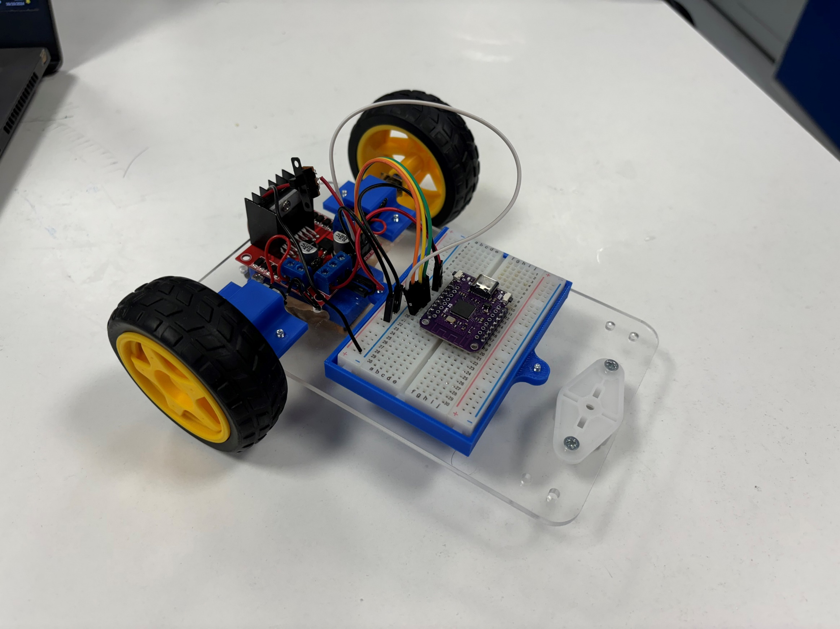
Goals
Introduction to Arduino
Basics of programming
Programming the 101 board
Finish the RC Car 🎉

Slide 3

Programming Microcontrollers
What is a microcontroller?
A small computer with at least one processor, memory and programmable IO.
Arduino IDE
Micro-Python
AVR-GCC + C
…

Slide 4
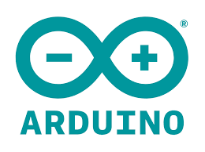

Arduino
Open-source electronics platform
Targets microcontrollers

Slide 5
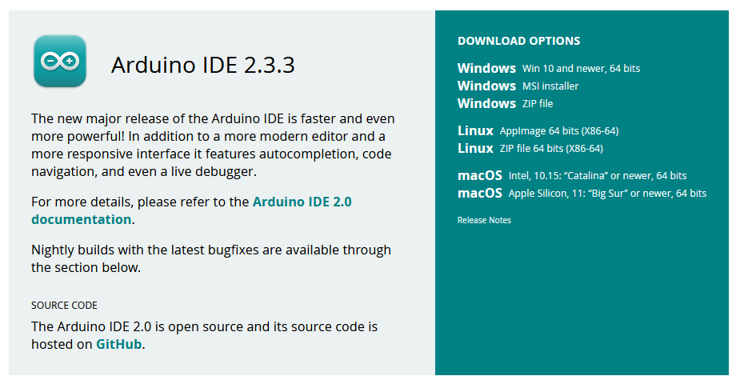
Arduino IDE Setup
https://www.arduino.cc/en/software

Slide 6
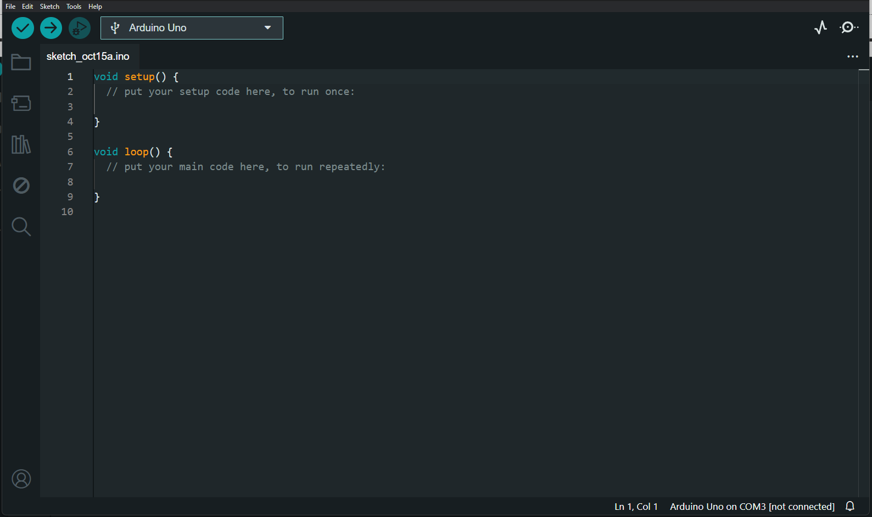

Slide 7
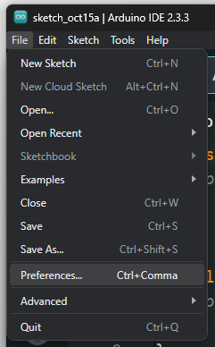
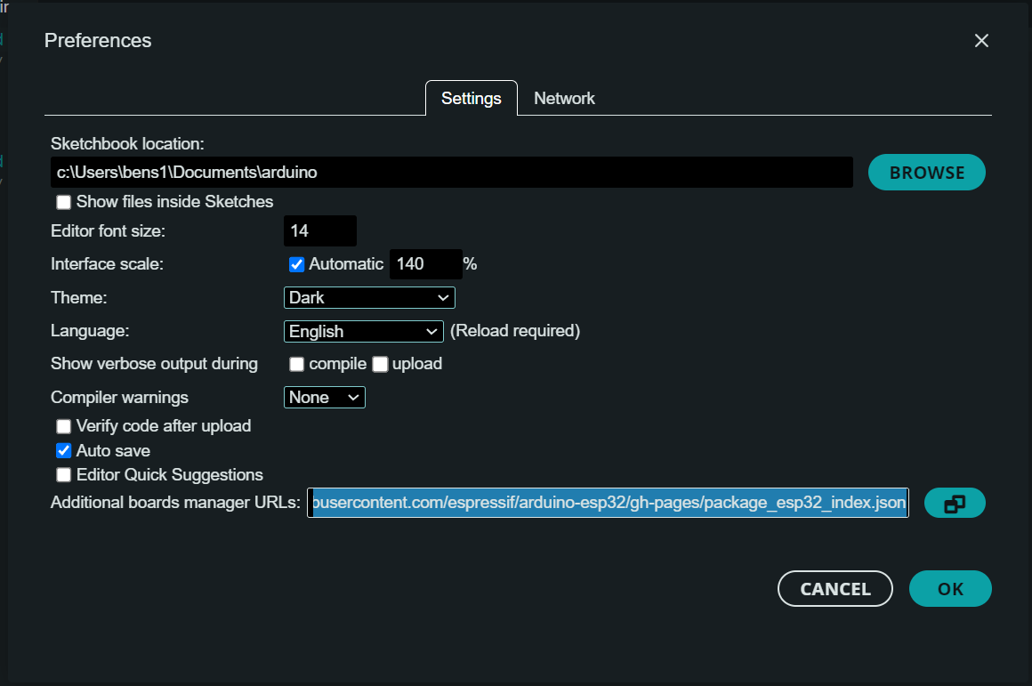
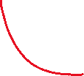

Arduino ESP32
https://raw.githubusercontent.com/espressif/arduino-esp32/gh-pages/package_esp32_index.json

Slide 8
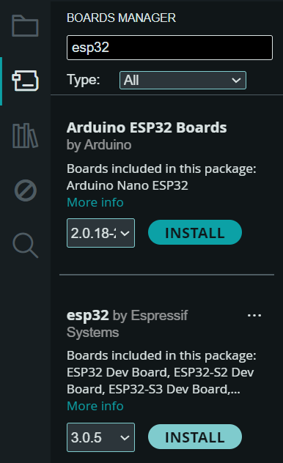
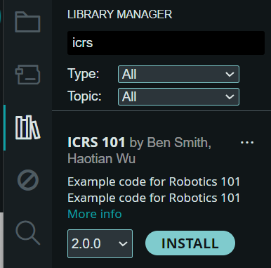


Add ESP32 Board and ICRS 101 Library

Slide 9
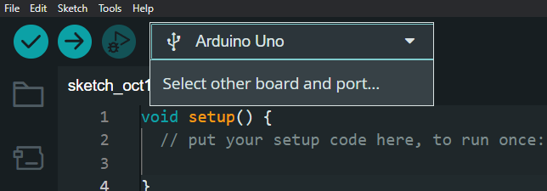
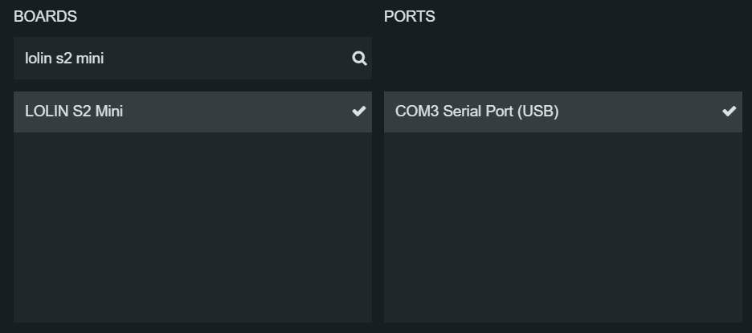

Slide 10
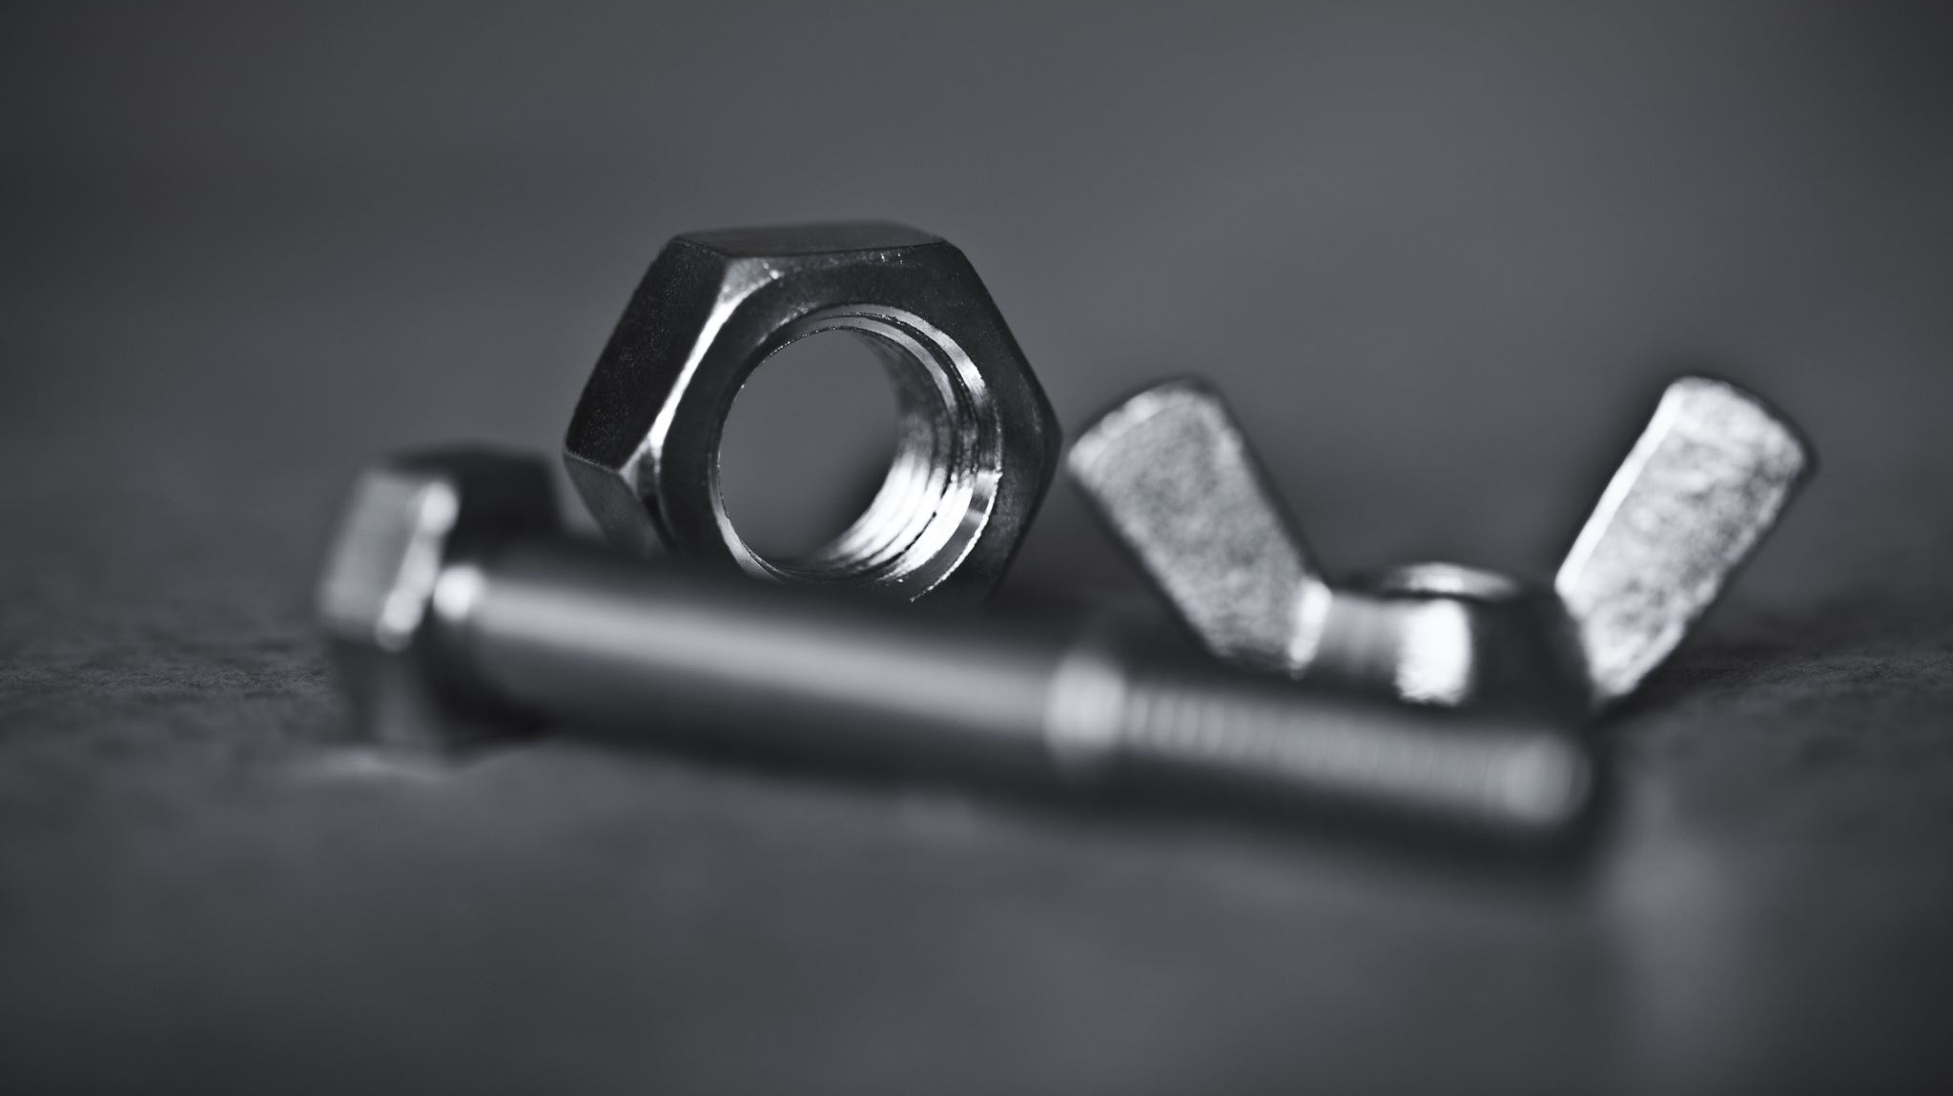
Hardware Recap

Slide 11
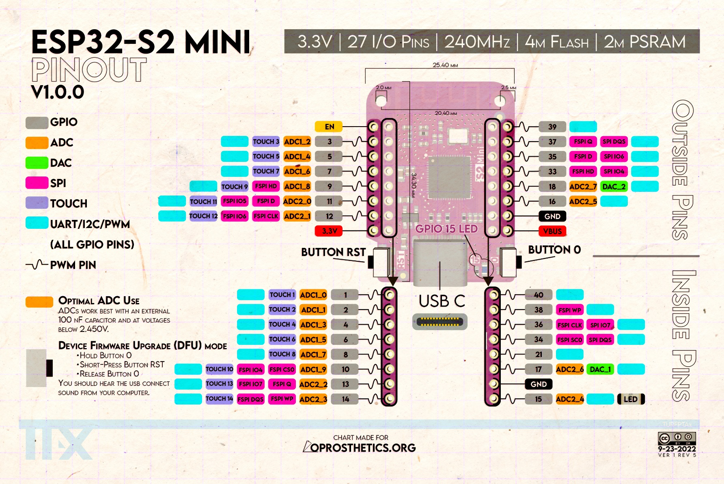
ESP32

Slide 12
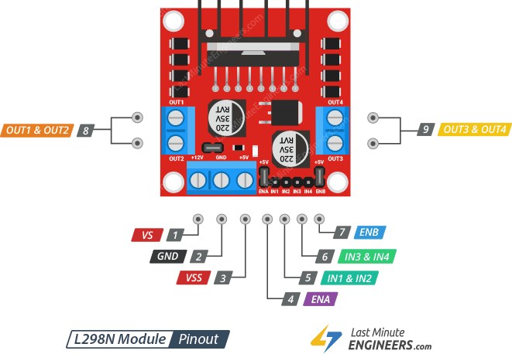
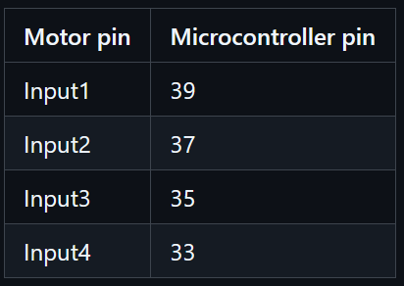
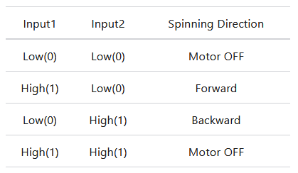
Motor Driver

Slide 13

Coding Time

Slide 14
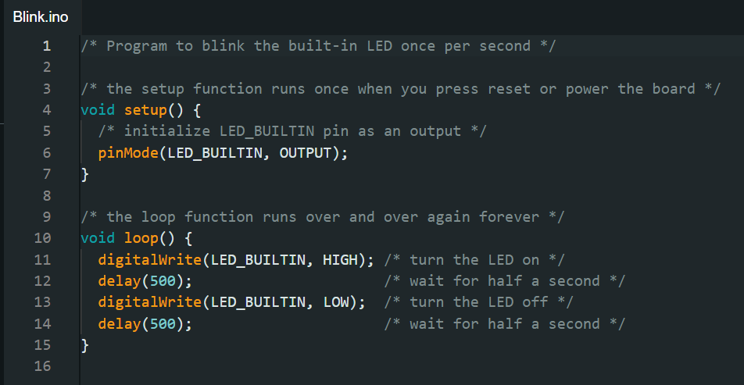
Blinky

Slide 15
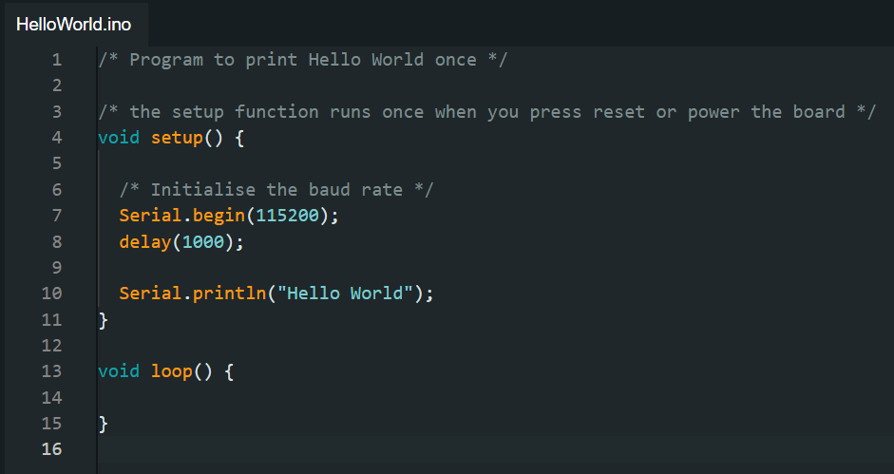
Serial Print ("Hello World")

Slide 16
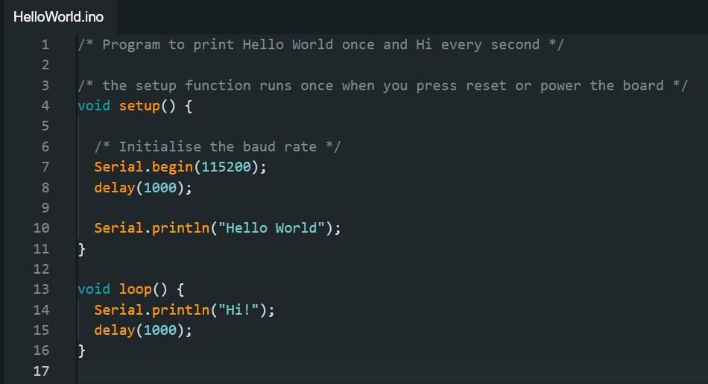
Serial Print ("Hello World")

Slide 17
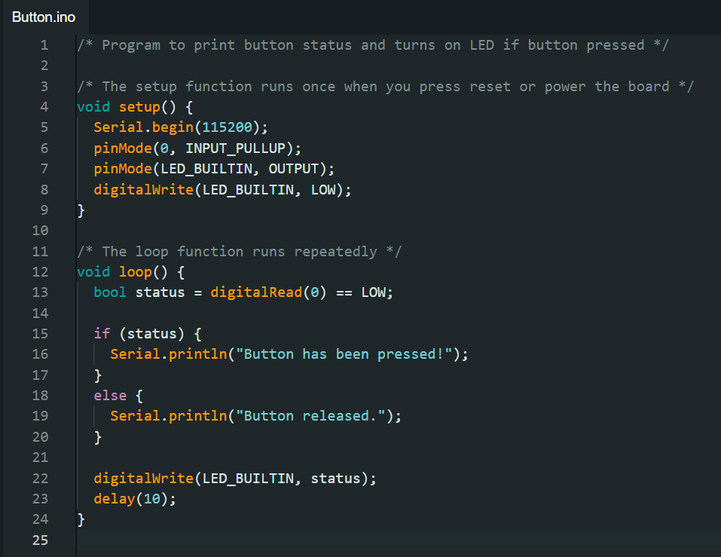
Digital IO

Slide 18
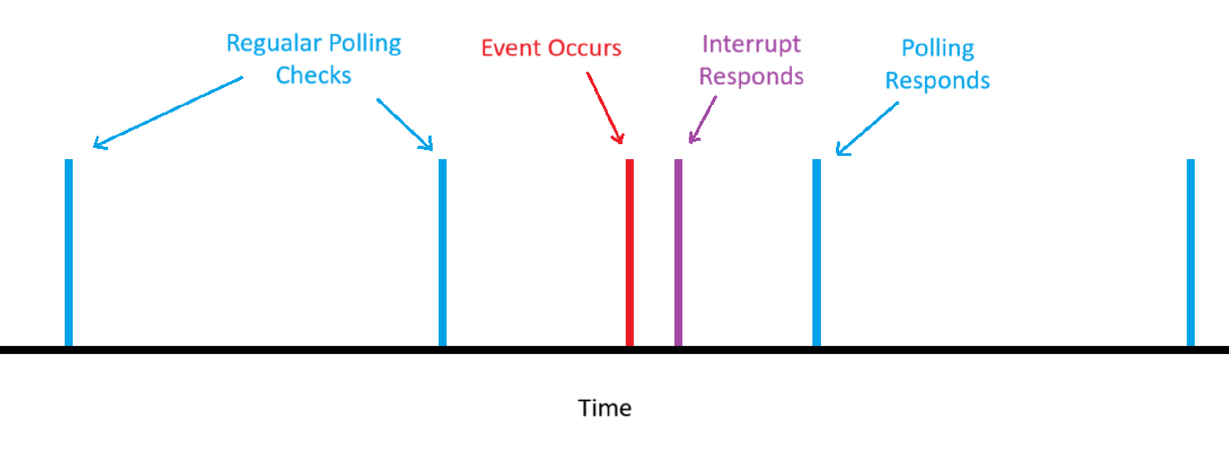
Polling vs Interrupts
Polling:
Wait and check a signal periodically
Easy to implement
Slow, lots of wasted CPU cycles
Interrupts
CPU stops what its doing to react to event
Harder to implement
Fast, no wasted CPU cycles

Slide 19
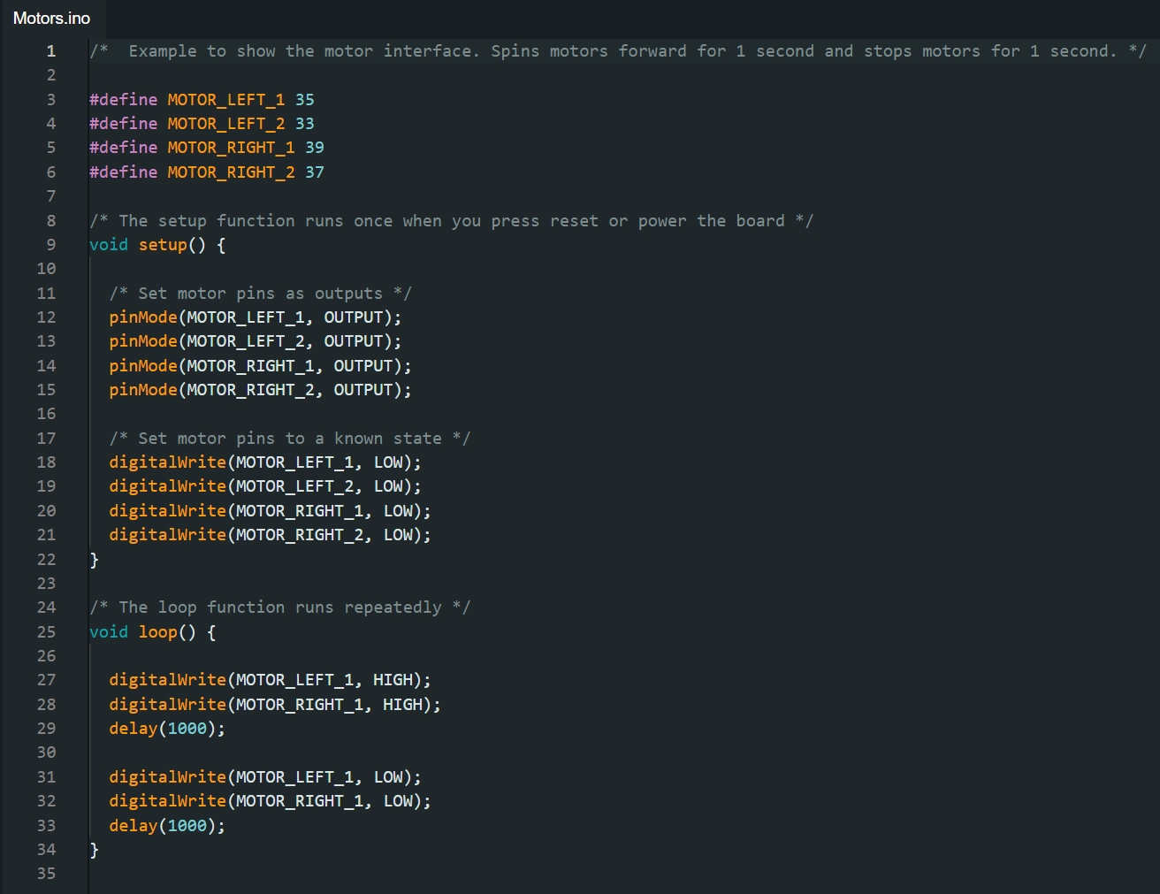
Motors

Slide 20
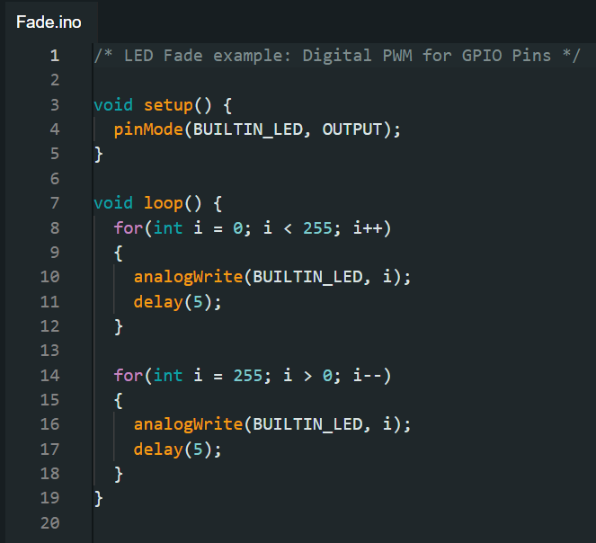
Analog GPIO

Slide 21

PWM Arduino

Slide 22
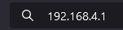

WiFi
File > Examples > ICRS 101 > WiFi > Joystick
Change the robot’s name to something unique in line 21:
Upload
Connect to the rover’s network and go to 192.168.4.1 in a web browser

Slide 23
Putting Everything Together

Slide 24
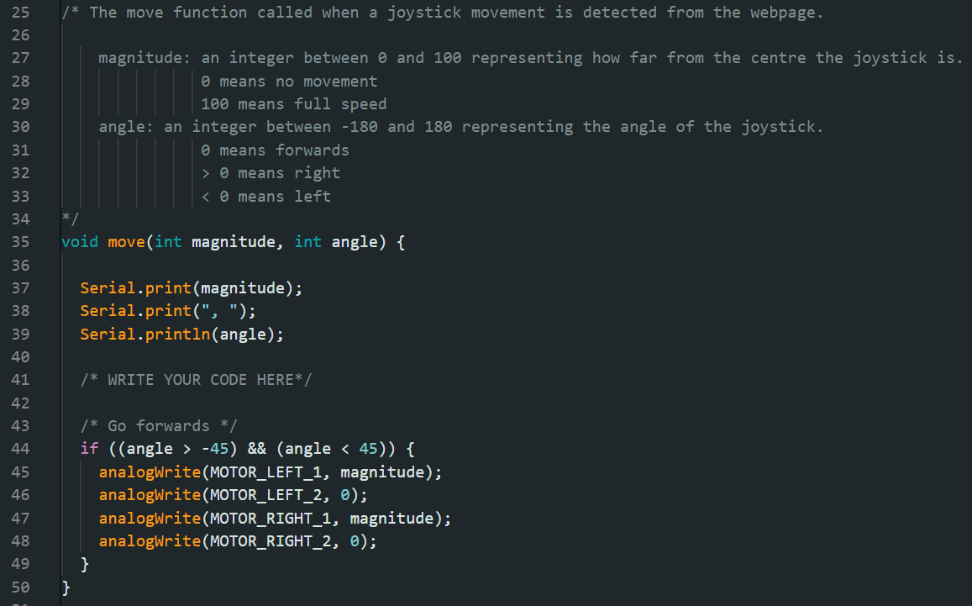

Slide 25
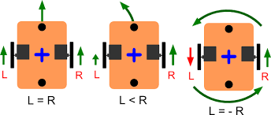
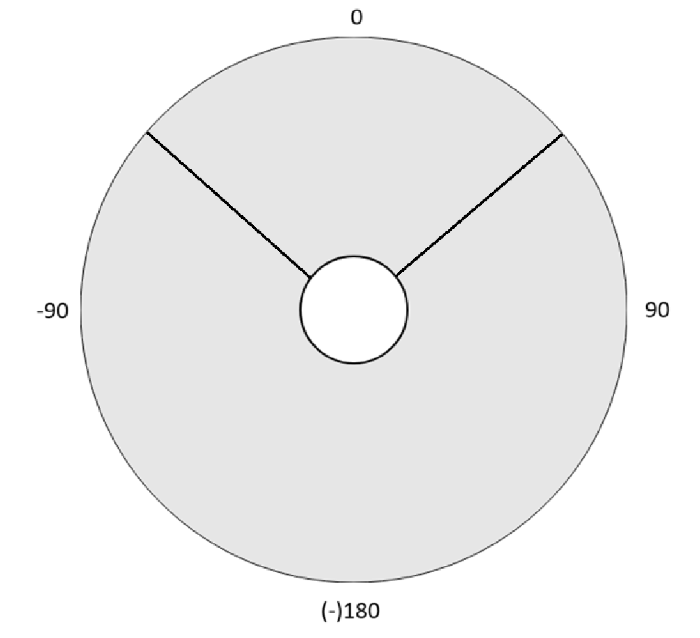

Slide 26
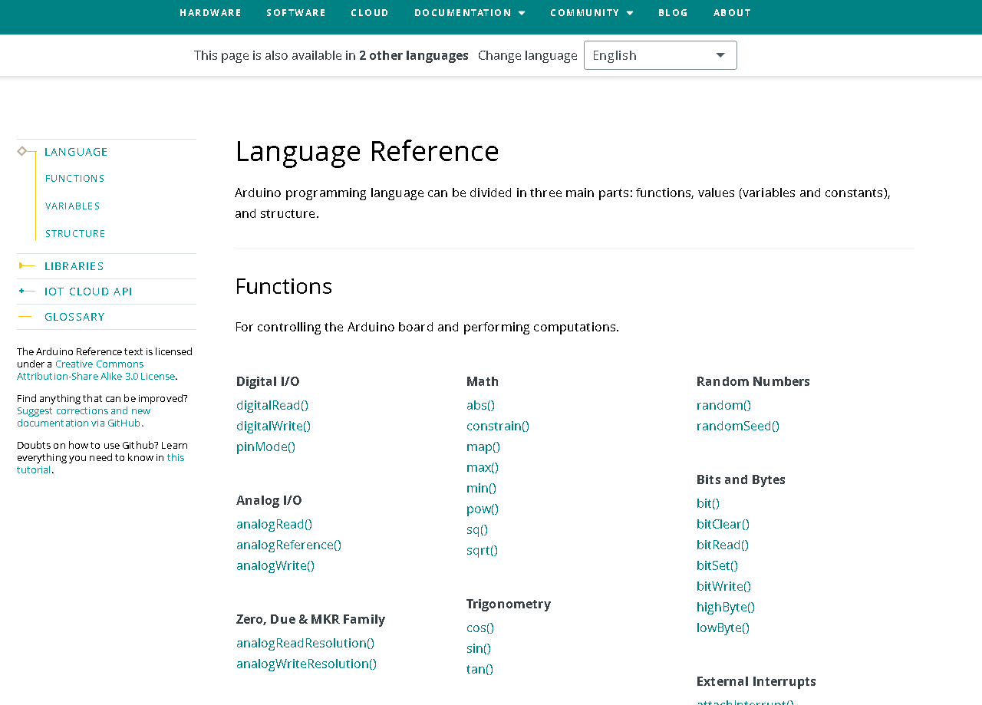
Arduino reference
https://www.arduino.cc/reference/en/

Slide 27

Code

